Slide 1
Introduction to CS Club!
October 5th, 2020

Slide 2
Introduction
This meeting we will cover:
What topics CS club will be focused on this year
After the meeting a poll will be posted regarding the topics in this presentation. Please vote on the choices you are interested in learning about!
We will also start learning about competitive programming!
Set up an account
How to read/understand problem statements
Example of a problem and solution
NOTE:
A signup form for computer science club will be posted alongside the poll after today's meeting! Please remember to fill it out before next Monday!

Slide 3
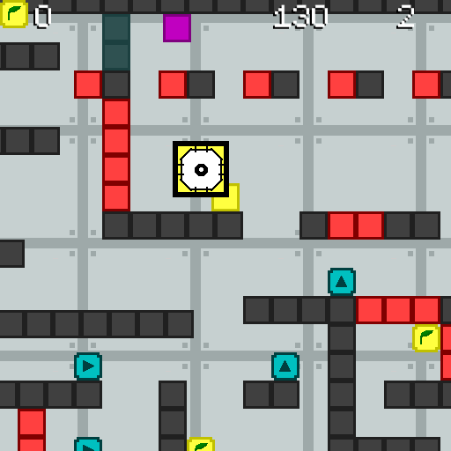
Game Development
One of the most fun ways to learn programming and software development is to make a video game!
Many video games are built with a game engine, which provide development tools to make game design easier. Examples of commonly used game engines include Unity, Unreal Engine, GameMaker Studio, and Godot.
The game to the right is a 2D platformer game I made with GameMaker Studio. Unity and Unreal Engine are good 3D game engines!

Slide 4

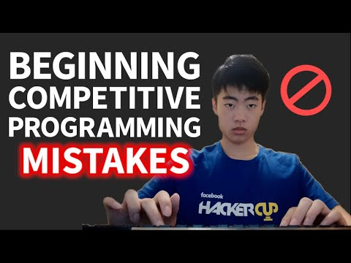
What is Competitive Programming?
Competitive programming is a mind sport where you create solutions to a problem.
Many problems relate to algorithms, math, and logical reasoning. Programs are then judged based on correctness, execution time, and memory usage.

Slide 5
Consider the following example:
Given two integers, a and b, compute and output their sum.
Sample input:
2
3
Sample output:
5
Now, we must find a way to create a program that solves this problem for us!

Slide 6
Solutions:
Python
a=int(input())
b=int(input())
print(a+b)
C++
#include <iostream>
int main() {
int a;
int b;
std::cin >> a;
std::cin >> b;
std::cout << a+b;
}
Java
import java.util.Scanner;
public class APlusB {
public static void main(String[] args) {
Scanner input = new Scanner(System.in);
int a = input.nextInt();
int b = input.nextInt();
System.out.println(a + b);
}
}

Slide 7
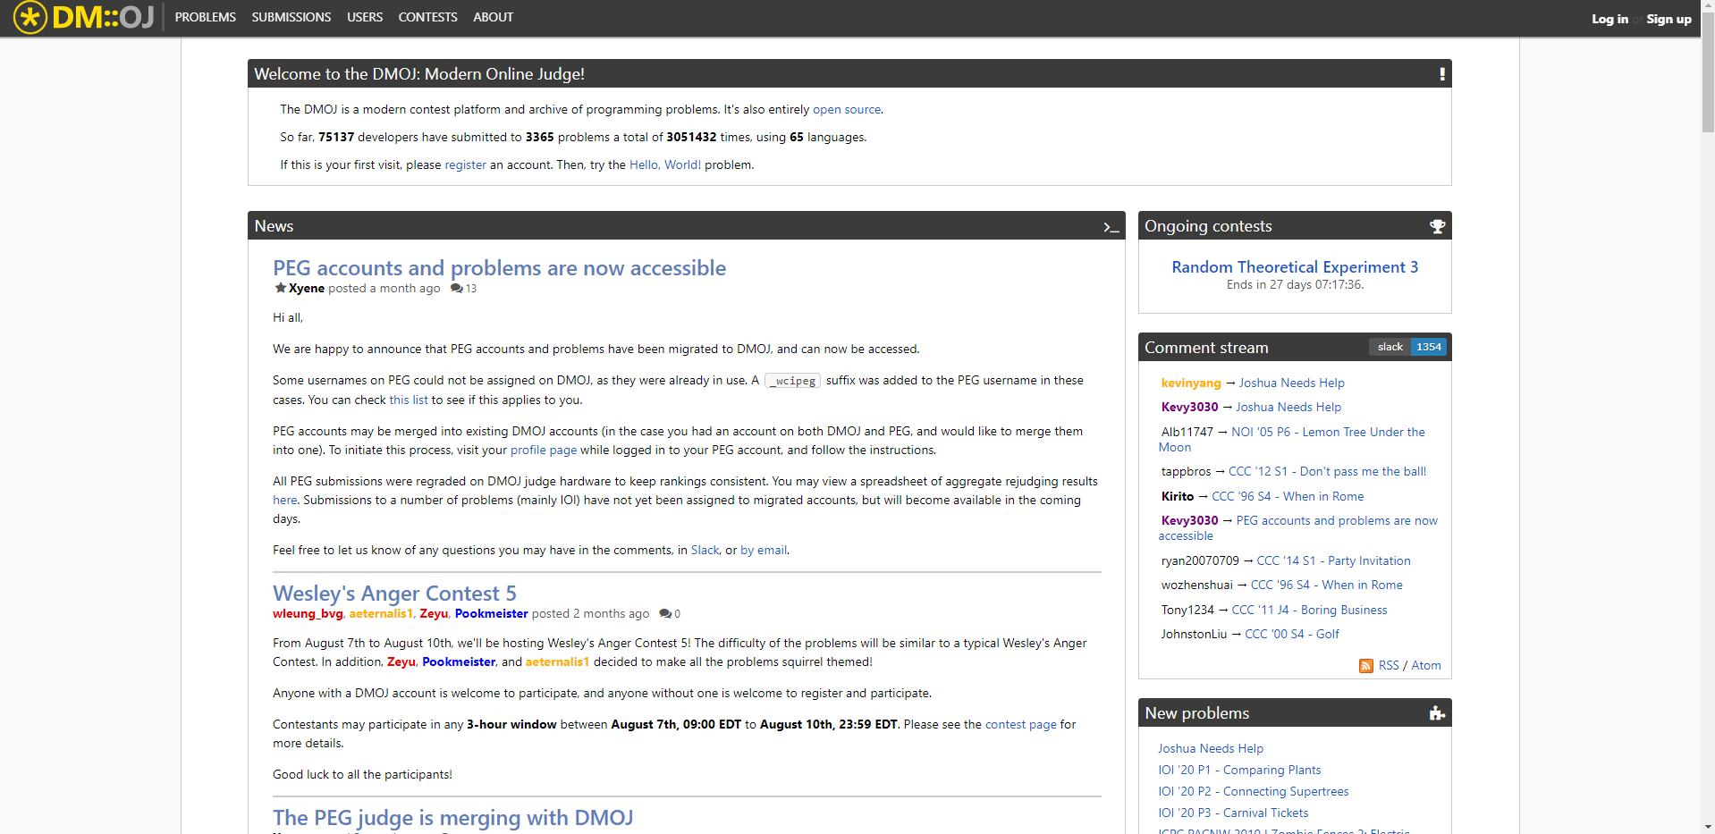
Registering your Account
Although there are many websites for competitive programming, this year we will be using dmoj.ca. Some other recommended websites are CodeForces.com and Atcoder.jp. Signing up enables you to submit solutions to problems in order to check whether they are correct. P.S. make sure to join the Woodlands SS organization on DMOJ ;)

Slide 8

Short Tour of DMOJ
There are many different sections on the DMOJ website. The most common one is the problems tab, where you can find a list of all available questions.
All questions are assigned a point value (ranging from 1-50), with lower points typically representing an easier problem.
In the case where your solution does not pass, you may be presented with an error code. The most common error code is WA (wrong answer), meaning your program’s output was incorrect.
More about error codes can be found here, and will be further discussed in future meetings.

Slide 9
Splitting into separate groups!
GROUP A:
Some experience in programming
Taken a computer science course or have learned previously
Confident with creating basic programs
Know things like for loops, data types, arrays, etcetc
If you believe you fulfill these requirements, please stay in this call!
GROUP B:
No prior experience in programming
Some prior experience in programming, but possibly forgot or not fully confident in programming abilities yet
If you believe you fulfill these requirements, please move to the other call! The link will be posted in chat.
We will continue our lesson in separate groups in 5 minutes.

Slide 10
GROUP A
Lesson format:
1. Introduce/teach new topics.
2. Present a question, and give you ~5 minutes to read the question and think of a solution.
3. Discuss the question, introduce any new topics that may need to learned to solve the problem, and write up a solution.
4. Problems related to the topics learned will be posted at the end of the slideshow. They are completely optional!

Slide 11
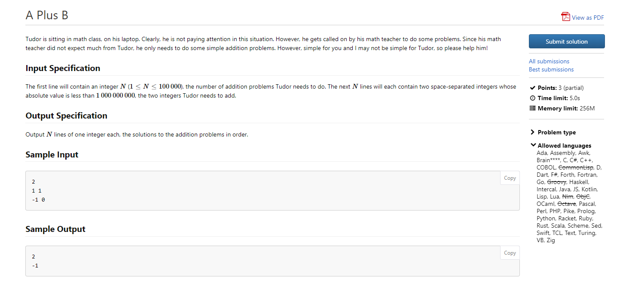
Reading & Understanding Problem Statements

Slide 12
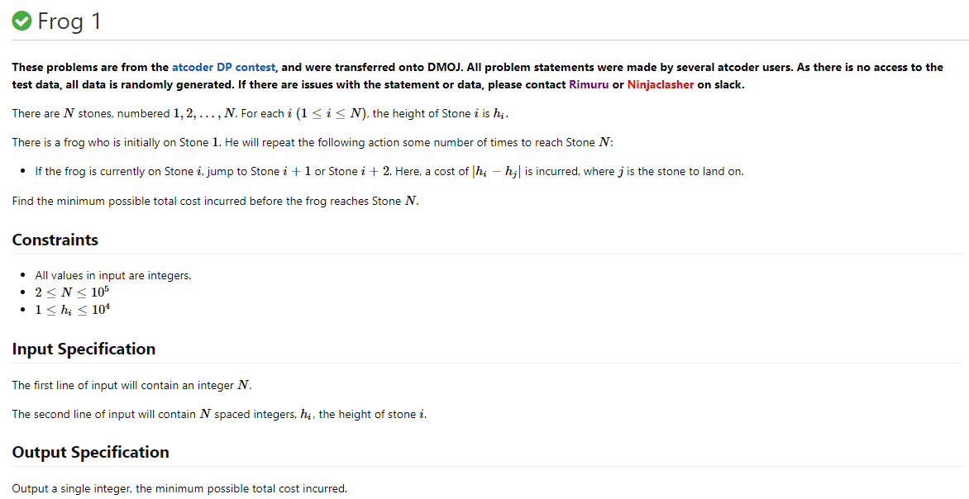
Reading & Understanding Problem Statements

Slide 13
Sample Cases
Edge Cases
Sample cases allow us to test our code before we submit our solution. It is always a good idea to test your code with all provided sample test cases.
Edge cases (also known as corner cases) are specific test cases that may cause your program to malfunction if not taken into account. Edges cases usually occur at the limit of constraints.
Consider the follow code to find the sum of an array of length N:
nums=[]
n=int(input())
for i in range(n):
num=int(input())
nums.append(num)
total=nums[0]
for i in range(1,n):
total += nums[i]
print(total)
An edge case for this code would be when n = 0. The code should output 0, since the sum of no elements is 0, but instead returns an index error since total cannot be initialized to nums[0] (as it does not exist).

Slide 14
Problem 1: https://dmoj.ca/problem/ccc15s1
CCC '15 S1 - Zero That Out

Slide 15
Solution:
This problem becomes difficult if we do not implement a stack. A stack is a basic data structure which supports two operations:
Push: Add an element to the end of the stack
Pop: Remove the last element from the stack
In Python, we can use the built-in list function. To add an element to the end of the list, we can use append(), and to remove an element from the end of the list, we can use pop().
In C++, we can use a vector or stack. When using a vector, we can use push_back() and pop_back() to add or remove elements from the back. When using a stack, we can use push() and pop() to add or remove elements from the top of the stack.
Once we are finished handling all of the bosses requests, we can loop through the stack to calculate the sum.

Slide 16
Solutions
Python
n=int(input())
st=[]
for i in range(n):
num=int(input())
if(num!=0):
st.append(num)
else:
st.pop()
print(sum(st))
C++
#include <bits/stdc++.h>
using namespace std;
stack<int> st;
int main() {
int n; cin >> n;
for(int i=0;i<n;i++) {
int num; cin >> num;
if(num!=0) {
st.push(num);
} else {
st.pop();
}
}
int sum=0;
while(!st.empty()) {
sum+=st.top();
st.pop();
}
cout << sum;
}
Can you think of any possible edge cases?

Slide 17
Problem 2: https://dmoj.ca/problem/set
Unique Elements

Slide 18
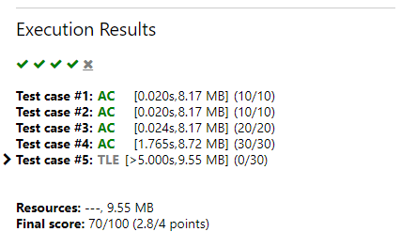
Idea:
Use a list to store all the numbers.
Every time we read a new number, we check if it is in the list. If it is already in the list, we do not add it. If it is not already in the list, then we add it.
Problem: This solution is too slow!(More on time complexity analysis later)
n=int(input())
nums=[]
for i in range(n):
num=int(input())
if(num in nums):continue
nums.append(num)
print(len(nums))
The code listed above will result in
TLE (time limit exceeded) as shown
on the right.

Slide 19
Solution:
In order to solve this problem, we need to learn about sets. A set is a data structure which stores unique values.
If we have the following list,
nums = [1,1,1,2,2,3,3,3,4,4,5,6]
And we convert it to a set, nums becomes:
{1, 2, 3, 4, 5, 6}
Thus, to solve this problem, we can simply use a set. Instead of checking whether the element is already present in our list, we instead directly insert the element into our set. Since our set only stores unique values, the size or length of our set at the end of the queries is the answer.
Sets in Python can be created using set(). Elements can be added using .add().
Sets in C++ can be created using set<data_type> set_name; Elements can be added by using .insert().

Slide 20
Solutions
Python
nums=set()
n=int(input())
for i in range(n):
num=int(input())
nums.add(num)
print(len(nums))
C++
#include <bits/stdc++.h>
using namespace std;
set<int> nums;
int main() {
int n; cin >> n;
for(int i=0;i<n;i++){
int num; cin >> num;
nums.insert(num);
}
cout << nums.size();
}

Slide 21
Problems:
https://dmoj.ca/problem/ccc14s3
CCC '14 S3 - The Geneva Confection (We will be taking this question up next class, so do not worry if you cannot solve it)
https://dmoj.ca/problem/nccc2j1
Mock CCC '18 Contest 2 J1 - An Arithmetic Problem
https://dmoj.ca/problem/dmopc14c2p1
DMOPC '14 Contest 2 P1 - Logging Log
https://dmoj.ca/problem/ccc15s2
CCC '15 S2 - Jerseys

Slide 22
GROUP B
Roadmap through competitive programming:
1. Good skills for competitive programming
2. What are algorithms?
3. Choosing a programming language
4. Getting started, downloading an IDE

Slide 23
Competitive Programming Skills
Even if you've never programmed before, there are some useful skills you may have.
1. Math skills can be useful, especially number theory and combinatorics. If you've done math contests, programming contests will be easier.
2. Reading comprehension is necessary for any problem.
3. Typing speed can sometimes be a factor in timed competitions.

Slide 24
What Are Algorithms?
In Computer Science Club, the core object of study is algorithms.
From Wikipedia:
"In mathematics and computer science, an algorithm is a finite sequence of well-defined, computer-implementable instructions, typically to solve a class of problems or to perform a computation."
Algorithms can be used to do many things, such as adding numbers, solving a maze, or baking a pie!

Slide 25

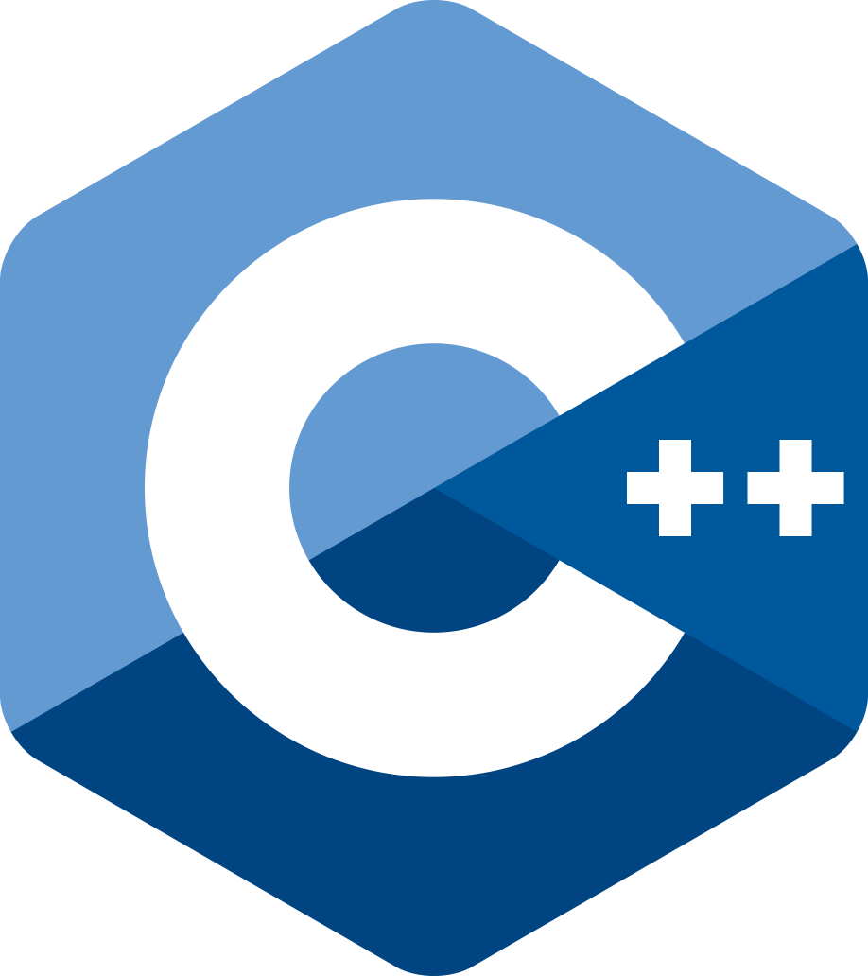

Choosing a Programming Language
Python is a popular beginner programming language. It's easy to use due to its readability and convenient functions (map, filter, lambda).
C++ is the most popular competitive programming language. It runs incredibly fast, which is important for questions.
Java is a popular language, usable for competitive programming and designing applications. It is good for android development and Minecraft mods.

Slide 26
Getting Started
To run a program on your computer, you'll need to download an IDE or a text editor with a compiler.
A simple IDE for Python is IDLE. It's a lightweight, minimalist IDE.
A good IDE for Java is Eclipse.
Good IDEs for C++ include Visual Studio and Code::Blocks.
Instead of downloading an IDE, a text editor can be used. Sublime Text and VSCode are good text editors. However, a separate compiler will need to be installed.

Slide 27
Questions

